Slide 1
Mnasri Amara Gomycode
Introduction to Databases Checkpoint

Slide 2
PLan
DataBase definition
What is a database management system?
What is NoSQL ?
NoSQL: MongoDB
What is SQL ?
NoSQL VS SQL.

Slide 3

DataBase definition
A database is a systematic collection of data. They support electronic storage and manipulation of data. Databases make data management easy.

Slide 4
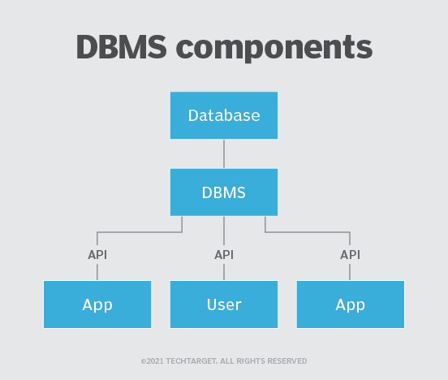
What is a database management system?
A DBMS enables users to create and manage a database. It also helps users create, read, update and delete data in a database, and it assists with logging and auditing functions.
The DBMS provides physical and logical independence from data. Users and applications do not need to know either the physical or logical locations of data. A DBMS can also limit and control access to the database and provide different views of the same database schema to multiple users.

Slide 5
What is NoSQL ?
NoSQL database stands for “Not Only SQL” or “Not SQL.”
NoSQL Database is a non-relational Data Management System, that does not require a fixed schema. It avoids joins, and is easy to scale. The major purpose of using a NoSQL database is for distributed data stores with humongous data storage needs. NoSQL is used for Big data and real-time web apps. For example, companies like Twitter, Facebook and Google collect terabytes of user data every single day.

Slide 6
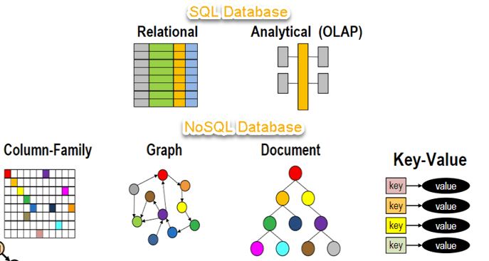

Slide 7

NoSQL: MongoDB
MongoDB is a database based on a non-relational document model. Thus, as a so-called NoSQL database (NoSQL = Not-only-SQL), it differs fundamentally from conventional relational databases such as Oracle, MySQL or the Microsoft SQL Server.
The name MongoDB is derived from the English word “humongous”, which roughly means “gigantic”. MongoDB was released in 2009 by founder and developer Eliot Horowitz,

Slide 8
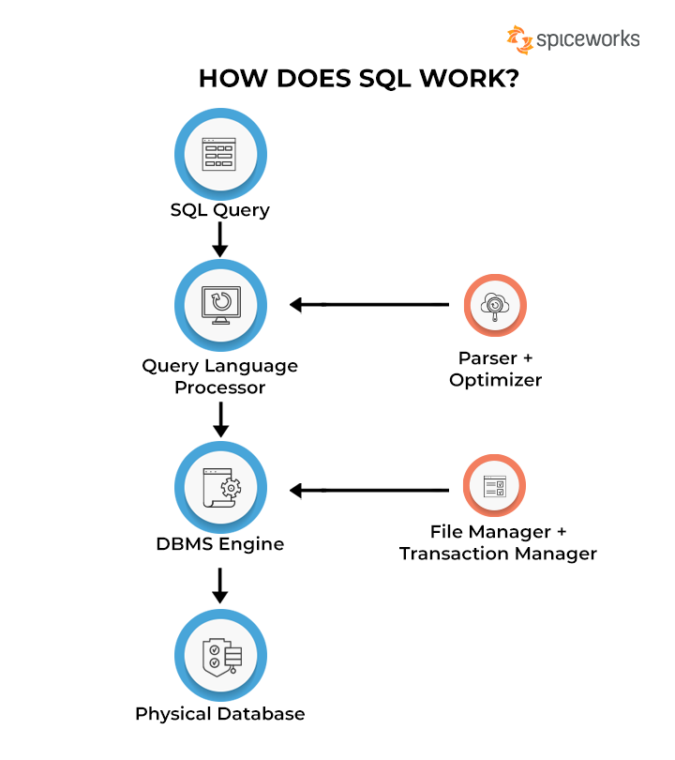
What Is SQL?
Structured Query Language (SQL) refers to a standard programming language utilized to extract, organize, manage, and manipulate data stored in relational databases. SQL is thereby referred to as a database language that can execute activities on databases that consist of tables made up of rows and columns.
SQL plays a crucial role in retrieving relevant data from databases, which can later be used by various platforms such as Python or R for analysis purposes. SQL can manage several data transactions simultaneously where large volumes of data are written concurrently.

Slide 9
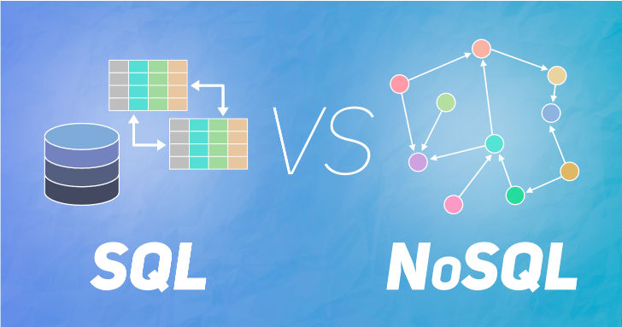

Slide 10
